Slide 1
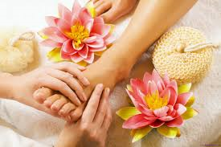
Marree, South Australia
SA Arid Lands
Women’s Retreat
Presented by
Lisa Stevens, Regional Landcare Facilitator (SA Arid Lands NRM) and
Jess Bell, Pastoralist (Dulkanina Station, Birdsville Track)
Notes:
Today I’m going to share a simple message and that is that people passion and determination can reap the greatest rewards.
Landcare is about connecting people and healthy landscapes, this was never truer than at the 2015 SA Arid Lands Women’s Retreat held in Marree. Here community was at the centre of Natural Resources Management in a way that had not been done before in the SA Arid Lands Region.
Similar women’s events have occurred in QLD, VIC and southern SA, however this event was the first of it’s kind to occur in outback SA and over one and half days women from around the Arid Lands region and beyond gathered to learn, be inspired and relax.

Slide 2
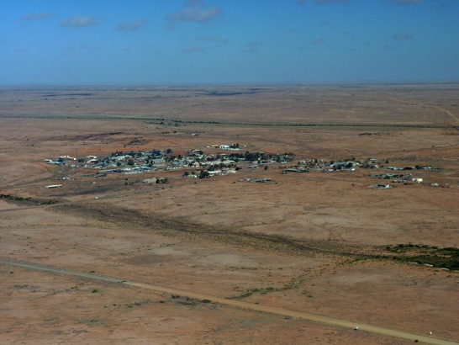
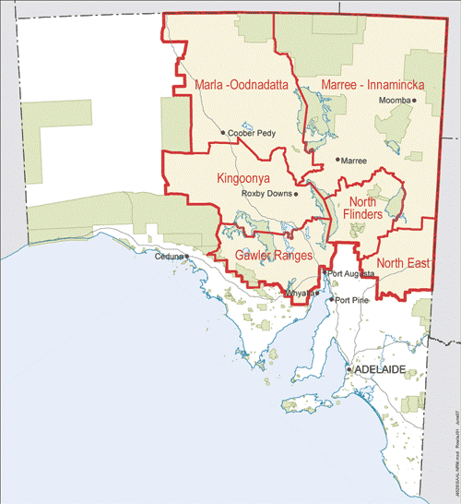
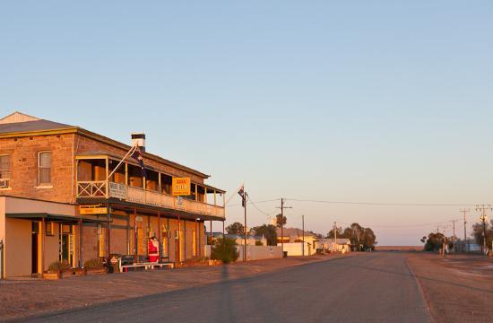
Setting the Scene
Notes:
The SA Arid Lands NRM Region occupies 50% of SA or around 500,000 km2 however with less than 2% of the population in the state bringing people together for any event is hard work. The SA Arid Lands is sheep and cattle country, no cropping at all. There were many challenges, one being to find a central-ish meeting point of the region and Marree seemed like the first logical place to host the inaugural women’s retreat.

Slide 3
The Organising Crew
Joanna Gibson
Wilgena Station
Ashlee White
Cowrie Station
Jess Bell
Dulkaninna Station
Megan Henderson
Mt Vivian and
Kokatha Stations
Lisa Stevens
Regional Landcare
Facilitator
Notes:
Another challenge was pulling it all off. Thankfully the organising crew were local women with many talents up their sleeves. These 4 inspiring women and myself brought it all together.

Slide 4
Taking a Risk … not everyone was on board
It’s not NRMy enough!
Do women really need an event just for them these days?
It’s just a bitch and champagne session?
Have you invited this person and that person ?
It’s just Kumbaya stuff, no offence
I didn’t know Landmark and PIRSA were coming, can I come?
Notes:
The clue is in the title RETREAT. Jess made it very clear from the start if you want to get pastoral women avoid words like conference, forum, seminar, symposium and meeting. It’s so simple yet clever marketing skills by using the word retreat conjures up the thought of luxury, relaxation, pampering and indulgence. The word RETREAT was effectively our ‘hook’, once we had people interested they then looked into what we were offering. Instead of ‘throwing’ NRM and government in their faces we weaved into the program so that it still fulfilled all NLP milestones and SUSAG deliverables and it fit in with NRM but we made it Modern.

Slide 5
Getting Hooked –
Engaging Remote Communities
What works
What doesn’t work
Early consultation
Using local landholder knowledge on a range of topics such as; local issues that might impact on event
Assuming “we” know what community want without asking
Relying on the same local champions

Slide 6
Retreat Themes
Women in Rural Business
  Diversification: Developing multiple sources of income
  Livestock Health and NLIS
  Land Management Panel (includes Pastoral Board, Landholder & Pastoral Profit
Arts & Crafts
  Silk scarf painting
  Jewellery making
  CWA activities
Health & Wellbeing
  Health Panel (includes RFDS doctor and community nurse, McGrath breast care nurse)
  Hatha Yoga
  Going Somewhere in the Middle of Nowhere (health, fitness & lifestyle
Self Development
  Believe in Yourself
  Living with Purpose and Passion
Notes:
We aimed to create an event to promote natural resource management in a clever and modern way – where NRM was interspersed throughout the program and intertwined through the four key themes of the retreat.

Slide 7
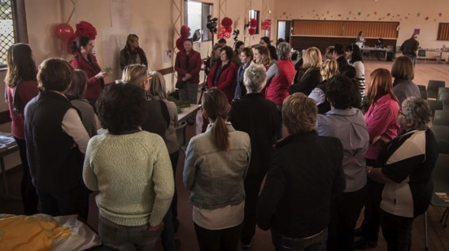
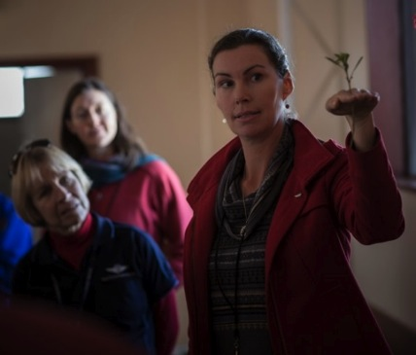
Masterchef - Arid Lands style
Paddock to Plate
Andrea teaches women about the incredible adaptions of native plants to the dry and salty outback environment
Home-made Salt Bush Dukkha
Quandong Jam
Andrea shares her lessons on preparing bush foods
Bush Bananas
Notes:
Paddock to Plate: Blending science and nrm to discuss nurturing, harvesting and preparing native plants not only for soil stabilisation, feed for sheep and cattle but the practical applications of native plants in every day cooking at home
Interactive – it was just a sit and listen – it was participatory and engaging.

Slide 8
Feedback – What did we learn?
Evaluation – Different Methods Used
Questionnaire (Survey Monkey)
Comments Box (at event)
Comments Wall (at event)
Video (at event)
Top 3 Sessions
Self Development – Believe in yourself
Health and Wellbeing – Health in the Bush (panel session
Livestock Health and National Identification System
Suggestions for future workshops
Furniture restoration
Vehicle servicing
SA women of the year as guest speaker
Health & Relationship
  Maintaining relationships (marriage) in isolation
  Depression
  Mental illness management
  Diet/ lifestyle
  Nutrition
  Education of children
Notes:
What did we learn?

Slide 9
Video

Slide 10
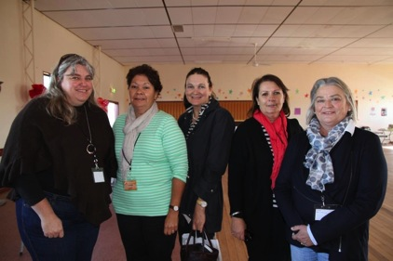
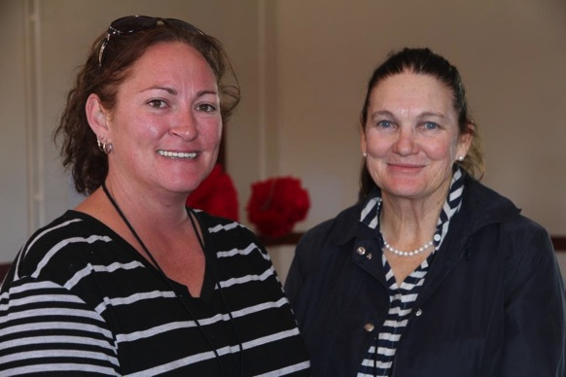
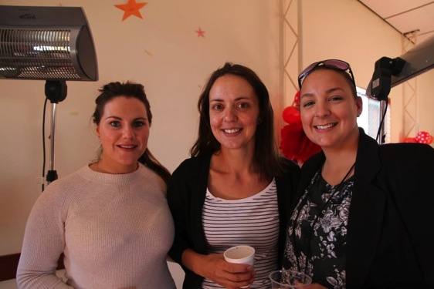
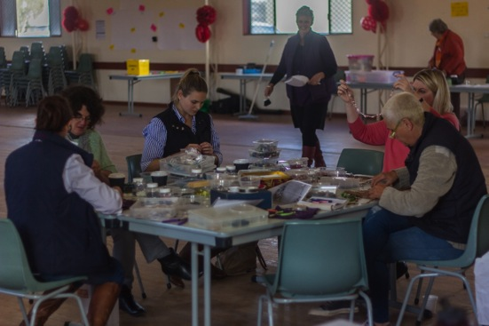
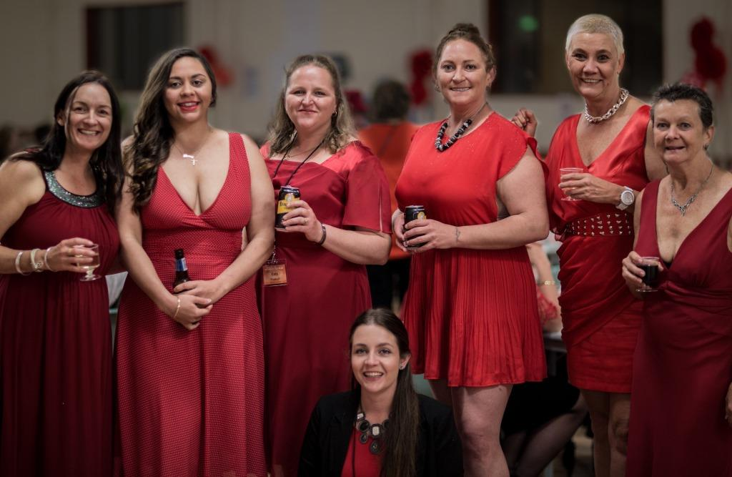
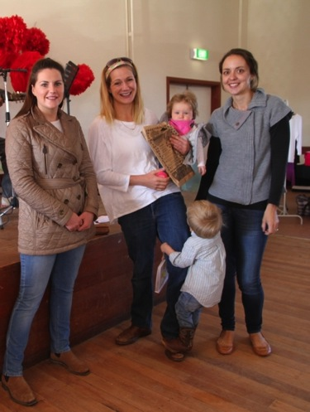
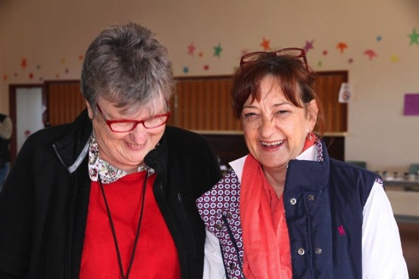
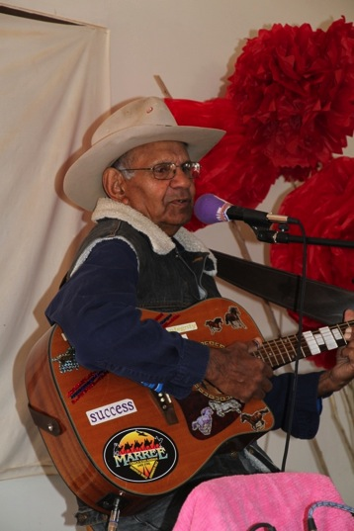
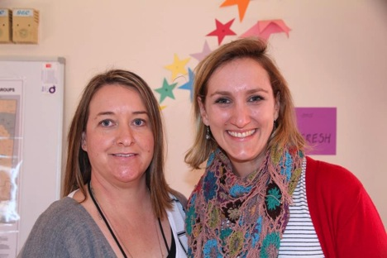
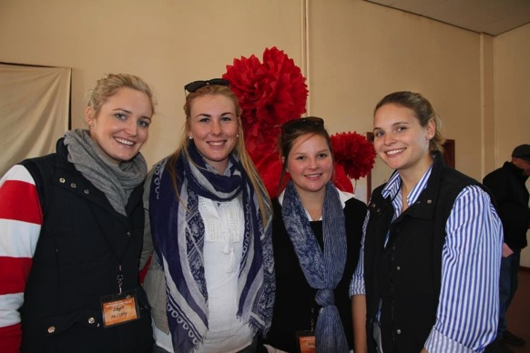
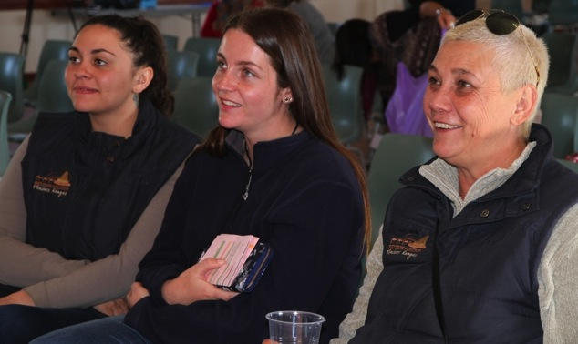
“Love the whole thing – the workshops were great and it was a good mix of topics – feel like I came away with lots of new ideas but also had the chance to take time out and do yoga and a bit of craft”
“I really enjoyed all my workshops”
“We, as outback women like to consider ourselves resilient and to a degree we have to be but there is nothing like an inspirational day to recharge”
“Women from the Outback being able to get together, spending time with old friends, meeting other like-minded people”
“I have no negative feedback. I felt that arrangement was terrific”
“Networking, meeting interesting people, building confidence and normal-ness”
“getting together with other bush women being inspired by sharing - occurring both from presenters and participants”
“Camaraderie and networking between the women”
Notes:
Take home message

Slide 11





Thank You
The
Marree Hotel

